Slide 1


MFM
Detecting AI-Generated Arabic Texts

Slide 2
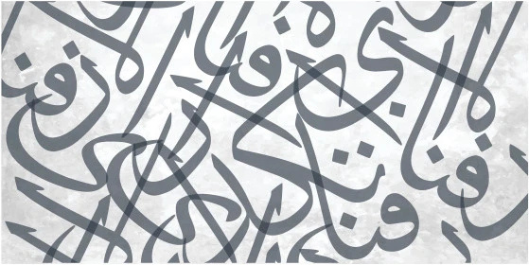
Problem Statement
Challenges in AI Detection
Arabic texts generated by AI models have become so similar to human texts that they are difficult to distinguish automatically. This project focuses on developing a classification model based on linguistic and stylistic characteristics to detect Arabic texts generated by artificial intelligence.

Slide 3
Dataset Overview
Data Source
The dataset comes from HuggingFace, specifically designed to facilitate research in AI-generated Arabic texts.
Exploring the Arabic-generated abstracts for analysis
Sample Size
It consists of over 8,000 abstracts categorized into human-written and AI-generated classes, ensuring robust analysis.
Text Type
The focus is on scientific Arabic abstracts, providing a diverse array of contexts for model training and evaluation.

Slide 4
Methodology Pipeline
Data Acquisition
Text Preprocessing
Data is collected from the HuggingFace dataset "arabic-generated-abstracts," consisting of over 8,000 abstracts for analysis.
Arabic texts are normalized and cleaned, removing stopwords and duplicates to ensure high-quality input for model training.
Feature Engineering
Model Training
Key linguistic features are extracted, focusing on lexical richness, structure, and syntactic elements to differentiate between text types.
Models are trained on the processed dataset, employing machine learning and deep learning techniques to develop an effective detection system.

Slide 5
Data Preprocessing
Normalization Techniques
Stopwords Removal
Normalization of Arabic letters focuses on Alef variants to ensure consistency and minimize discrepancies across text samples.
Removal of stopwords, punctuation, and non-Arabic symbols enhances the quality of the text, reducing noise for further analysis.
Duplicate Handling
Stemming Process
Duplicate records are identified and removed to maintain data integrity, ensuring that each sample is unique for analysis.
Stemming using the ISRI Arabic Stemmer extracts morphological roots, helping to standardize words and improve feature extraction.
Missing Values
Handling missing values is essential for maintaining data quality, preventing bias in the model due to incomplete information.

Slide 6
Key Features
Lexical Richness
Sentence Structure
Lexical richness metrics like Yule’s K and Simpson’s Index quantify vocabulary diversity, influencing the detection of AI-generated texts.
Analyzing sentence and paragraph structures helps identify patterns typical of AI-generated content, contributing to more accurate classification.
Readability Metrics
Diacritics Usage
Readability scores, such as Flesch–Kincaid, provide insights into text complexity, differentiating between human and AI writing styles effectively.
The frequency of diacritics (Tashkeel) in the text serves as an essential feature for distinguishing stylistic differences in Arabic writing.
Semantic Features
Utilizing BERT embeddings captures nuanced semantic relationships, enhancing the model's ability to discern AI-generated text from human-crafted content.

Slide 7
Model Selection
Selected Models
The study utilized various models, including Logistic Regression and Support Vector Machine for robust baseline comparisons in performance.
Evaluating Approaches for Arabic Text Detection
Deep Learning
AraBERT v02 showcased superior performance, leveraging deep learning's capabilities for understanding and classifying complex Arabic text nuances effectively.
Training Split
A 70%-15%-15% data split was implemented to train, validate, and test the models, ensuring reliable performance metrics and evaluation.

Slide 8
Results Summary
Model Performance
Comparative Insights
The AraBERT model achieved exceptional accuracy of 99.63%, demonstrating its effectiveness in detecting AI-generated Arabic texts.
Traditional models like Random Forest and SVM displayed solid performance, yet they lagged behind deep learning methods in understanding semantics.
Feature Impact
Implications for Future
Key features such as diacritics and sentence structure played a crucial role, contributing significantly to the model's classification capabilities.
The results highlight the need for further research into enhancing detection tools, ensuring the integrity of Arabic text in academic settings.
Model | Accuracy | F1-Score (Target: AI) | Precision (AI) | Recall (AI) | ROC-AUC
BERT | 99.63% | 0.9977 | 0.9980 | 0.9974 | 0.9994
Random Forest | 98.59% | 0.9911 | 0.9936 | 0.9887 | 0.9954
SVM | 95.77% | 0.9738 | 0.9656 | 0.9821 | 0.9846
Logistic Regression | 94.45% | 0.9649 | 0.9780 | 0.9521 | 0.9796

Slide 9
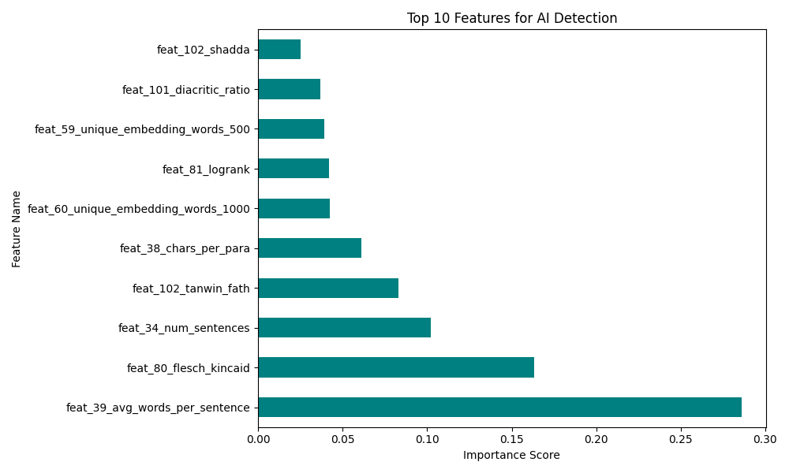
Feature Importance
Diacritics Usage
Diacritics (Tashkeel) proved to be the most influential feature, significantly impacting the model's decision-making process and accuracy.
Unveiling key factors in AI text classification
Sentence Length
Sentence length emerged as a critical differentiator, allowing the model to effectively classify texts based on structural patterns.
Readability Metrics
Readability scores, such as Flesch-Kincaid, were essential in discerning between AI-generated and human-written texts, enhancing classification accuracy.

Slide 10
Error Analysis
Misclassification Rate
Error Patterns
The BERT model exhibited a misclassification rate of only 0.54%, indicating its high effectiveness in detecting AI-generated Arabic texts.
Errors primarily occurred in formal academic writings, suggesting a style overlap between AI-generated content and certain human-written texts.
Feature Analysis
Future Improvements
Diacritics emerged as the most influential feature, indicating their significance in distinguishing between AI-generated and human texts effectively.
Understanding these errors provides valuable insights for future model enhancements, refining performance in edge cases of detection.
Implications
The findings highlight the need for improved training data to address specific stylistic overlaps and enhance detection accuracy.

Slide 11
Conclusion
AraBERT provides state-of-the-art performance for Arabic AI text detection.
Random Forest offers a strong, interpretable alternative.
Linguistic and stylistic features are highly effective for Arabic.
The study confirms that AI-generated Arabic text leaves measurable statistical fingerprints.

